Slide 1
AcademiaPlus
0
+1
Supervisor:
Dinesh Neupane
Presented By:
Suman Khatri

Slide 2
Contents
INTRODUCTION
PROBLEM STATEMENT
OBJECTIVE
METHODOLOGY
FLOW CHART
TOOLS USED
GANTT CHART
CONCLUSION

Slide 3
INTRODUCTION
AcademiaPlus is a web application designed to streamline and automate administrative tasks in educational institutions. It facilitates efficient handling of student records, attendance tracking, timetable management, and grade reporting, enhancing communication and collaboration among teachers, students, and administrators.
+8

Slide 4
PROBLEM STATEMENT
• User Authentication: Ensure secure access for registered users only. • TwoWay Attendance: Enable real-time attendance marking and confirmation by both students and teachers. • Routine Management: Provide tools for efficient creation and updating of class schedules. • Marks Management: Facilitate recording, tracking, and reporting of student grades.
+7
5
4

Slide 5
OBJECTIVES
• User-Friendly Interface: • Privacy and Security: • Reliability:
+7
5
4

Slide 6
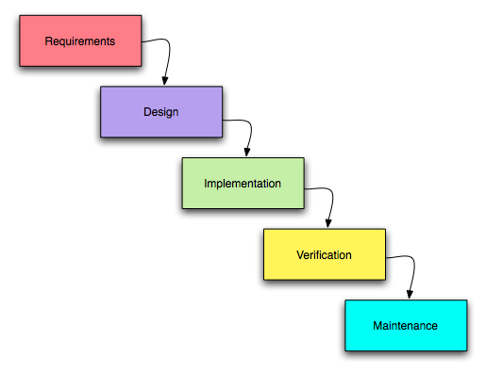
METHODOLOGY
We'll use the Waterfall methodology for AcademiaPlus, completing each phase requirements, design, implementation, testing, and maintenance sequentially for a structured and disciplined development process.
+7

Slide 7
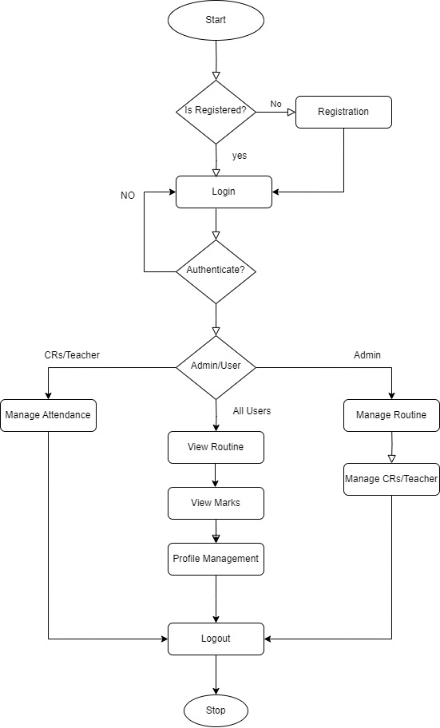
FLOW CHART

Slide 8




TOOLS USED
Next.js and Tailwind will be used in frontend to build User Interface.
Node.js will be used for backend and PostgreSQL will be used for database.

Slide 9
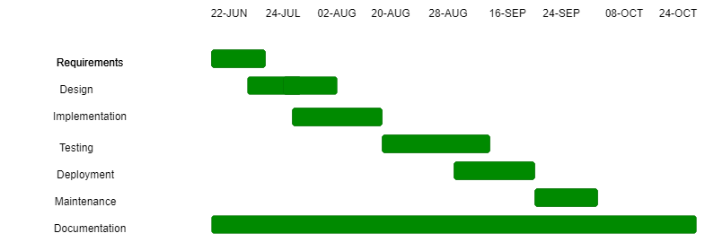
GANTT CHART

Slide 10
CONCLUSION
This project is a comprehensive academic management system, AcademiaPlus, designed to meet identified requirements and improve upon existing solutions. It will offer a secure, reliable, and user-friendly platform for managing attendance, routines, and marks.

